Slide 1

ARBA MINCH UNIVERSITY DEPARTMENT OF CSIT
Import Management System
For
Agmas Medical Private Company

Slide 2
Content Outline
Introduction
Problem statement
Objective of the Project
Scope of the project
Functional requirements
Non-functional requirements
Implementation and Testing
Conclusions
Recommendations

Slide 3
Introduction
Import Management System is the system that allows the very soft relation between the suppliers, Agmas Medical Import Company& distributors.
Those are easily interacted by system Import Management System. Import management activities are performed manually; it takes a lot of time to finish all the activities.
There is no searching and data retrieving mechanism. The new system is developed using the HTML, CSS, JavaScript, PHP and MySQLProgramming language.
The module includes operation like online payment, searching mechanism, adding suppliers and distributors and ordering products.

Slide 4
Problem statement
the current system is manual systems which have many problems in relation to import process and database management.
Lack of Online payment.
There is redundancy of activities.
Data is not secure as well as it is not well organized.
It takes a lot of time to finish all the activities.
Customers do not get the required information and report on time.
current system makes the performance of the company slower.

Slide 5
Objective of the Project
General Objective
To develop web based import Information management system.
Specific Objectives
Use system initiation and planning phase for starting and setting outline of schedule and budget for developing the proposed system.
Requirement gathering and elicitation.
Provide easy searching mechanism.
To develop centralize database
Provide a user friendly user interface.
Implement the system according to the requirement business processes.
Use design and analysis step to identify the suitable models and designs for the system.

Slide 6
Scope of the project
The system will be designed to maximize the imported product by providing online information transferring and the order transferring between the stalk holders.
Registration for suppliers and distributors.
View product price.
Order product
E-mail communication.
Online payment system.
Searching mechanism.
Advertisement.

Slide 7
Functional requirements
Functional requirements specify specific behavior or functions.
Company Administrator
Create account
Update account
Control Manager
Company Manager
Add supplier and distributers
Order item
Send e-mail
Online payment
Manage supplier
Generate report
View order

Slide 8
…
Supplier
View profile
View order
Add product
Login
Send e-mail
View message
Distributers
Order item
View product
Login
Online payment
Send e-mail
View massage

Slide 9
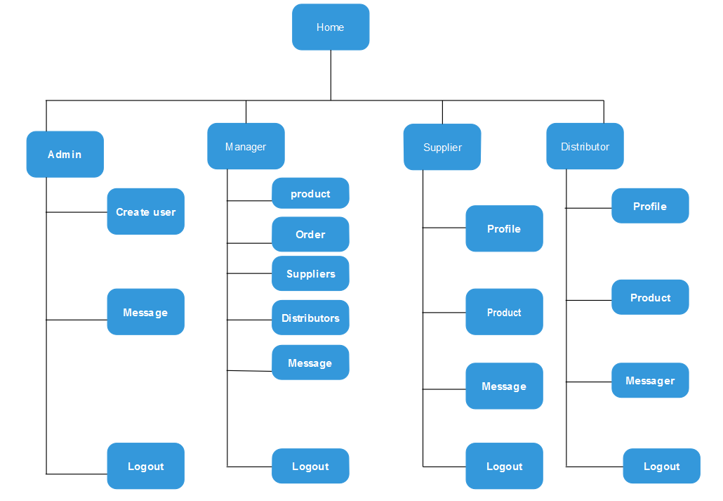
The system interface

Slide 10
Nonfunctional requirements
focus on the quality of the application systems needed to be developed from different evaluations point of view.
Security:
The interface of this system consists of Login form for the registered users.
Users must be registered in order to enter into the page.
The system should be secure and must use encryption to protect the databases.
Efficiency:
The system must ensure allocation and use of services being requested for the users by using minimum memory storage, cost, time and human power.

Slide 11
Reliability:
The reliability of the proposed system will be better due to proper storage of information when users access the application.
Accuracy: proposed system will be better due to reduction of error. All operation can be done correctly and it ensures that whatever information is coming from the data base is accurate.
Performance:
The performance of the system will depend on availability in which the site will be available all the time.
Avoiding redundancy of codes increase the time of operation and memory space of the system.

Slide 12
…
User friendly Interface:
The system consists of Login form for the registered users .
users must be registered in order to enter into the page.
Registered user has the interface to access the order and product information.
Administrator has also its own interface for registering users, validate different customers and update users’ information.
The system has report form which generates the important process reports.
Backup and Recovery
If the connection between the supplier, distributor and the system is break down the system will automatically save the filled information and the remaining can enable by the administrator by contacting the costumer using phone or email.
To recover a data we will have a copy of the original data in another place.

Slide 13
Implementation and Testing
The testing phase involves some modification to the pervious design phase and system testing has been done to minimize the programming and system error
During implementation and operation, physical design specification must be turned into working computer code, and then the code is tested until most of the errors have been detected and corrected.
The user sites are prepared for new system and user must come totally on the new system rather than the existing.

Slide 14
Final Testing of the system
Black box testing
To test our system, the tester may use black box testing.
, if he/she has not enough time to check internal modules or codes.
By looking only input /output or user interface, the tester can test our systems functionalities without looking the internal code.
This testing type is more effective on larger units of code.
Tester needs no knowledge of implementation, including specific programming languages.
Tester and programmer are independent of each other.
Tests are done from a user's point of view.

Slide 15
White box testing
In this type of testing, skilled man in different programming languages tries to test the logic of our system.
If the person who tests the system is not skilled, it is difficult to understand our systems functionality.
If any failures occur while testing the system in all of the above testing methods, the team will take immediate correction where this fault occurred before jumping to next work. So, that it will meet the goal.

Slide 16
Unit testing
In this level of testing process, the import management system developers test the different sub procedures, functions and tested by applying the black box and white box testing.
Sample Tests
Check whether the return type of the functions is correct.
Check how the sub procedures or functions are called correctly.
Check if the correct output is produced for different inputs.

Slide 17
Integration testing
In this level of testing we have examined how the different procedures work together to achieve the goal of the sub system.
Sample Tests
Get Add supplier (supplier ID) function is called after the set Add supplier (supplier ID) is invoked for the particular supplier ID otherwise it calls the error function.

Slide 18
User acceptance testing
To verify if specific requirements are working for the user we use feedback from users as a testing method.
If the feedback is positive and there is no identified problem the system will continue operating as it is, otherwise the identified problem will be solved.

Slide 19
Hardware software acquisitions
Hardware acquisitions
Computers: for client side and server side TOSHIBA with Hard Disk: 699GB RAM: 4GB Processor: Intel Core 5 DUO CPU (TM) i5-3210m @ 2.5GHZ (4cpus), ~2.5GHz
Printer: To printing the documents.
Server: To create connection to the client computer (to host the system)
Software acquisitions
PHP designer
Xammp server
MySQL database
Notepad ++
Microsoft Windows 8 and Windows 7 Ultimate SP1

Slide 20
User manual preparation
Since the system is web based and easily user friend, everything important for the users will be explained and implemented while giving short training when the system is deployed.
There is no need of preparing full user manual because it is only deployed (hosted) on a single machine that is server.
So anyone who can access the internet can also access the system easily within the given permission by the system administrator.

Slide 21
Training
During the deployment of this system, the project group members will give short time training for the system administrator and importer how the system works and in what way they can manage their system.
Installation Process
Our system is a web based System, there is no need to install it on particular machine ones it is deployed on a server by developer, the user of the system can use it at any time and any place.

Slide 22
Start-up strategy
Once the system is hosted, it has two start-up strategies:
the first start-up strategy is for the administrator, manager, supplier and distributor which require the username and password to access the system. The user’s accessibility part is restricted for the users and the other one is for system administrator.
The second start-up strategy part is the system home page which does not require the username and password and it can be viewed by anybody

Slide 23
Conclusions
So far we were intended in analyzing the existing system of the Agmas Medical Import management system up to proposing our new system that solves the difficulties related to the existing system.
It is known that developing a web based system for Agmas Medical Importer company how is importing manage by the system is not easy and system will facilitate the overall process of importing products.
But the team has developed interesting web based Import management system for Agmas Medical Private Company.
This system that allows the very soft relation between the suppliers, Import Company & distributors.

Slide 24
Recommendations
We would like to recommend that the system is open for interested groups or individuals who wish to add new functionalities especially stock management.
Next, the team would recommend that further work should be done on the system in order to make the system fully functional like official website.
Finally we would like to recommend to the Agmas Medical to use this system to enhance the import management process by using our system.

Slide 25
THANKS!!

